Slide 1


STOCK PRICE PREDICTION USING LSTM & TEXT BASED SENTIMENT ANALYSIS
MITA CAPSTONE PROJECT
Guided by Prof. Sergei Shreider
GROUP MEMBERS:
SHAMALI SHAH
AKASH NIVRUTTI YEDE

Slide 2

Introduction
The project idea is to help marketers and investors in making decisions whether they should invest in any of the four airline stocks.
Airline industry has seen a great down fall in 2020, causing a drop in their stock prices
Most of the airline stock prices were all-time high in 2019.
The stock prices are now gradually increasing as their business stabilizes.

Slide 3

Goal of the Project & Target Audience
Goal of the Project
The goal of the project is to help investors in analyzing and decision-making to invest in airline stocks.
They don’t have to be staying updated with the latest happenings in the airline industry before deciding to invest in a particular airline stocks.
LSTM being one of the strongest mechanisms to analyze financial time series, it gives us near to perfect prediction results.
Target Audience
Investor who wishes to invest in airline stocks.
Beginners who want to invest in airline stocks.
Marketers who follow the airline business.

Slide 4

Scraping Stock Price Data
The prediction requires us to fetch the current stock price data.
Using the DataReader library to fetch the live data from Yahoo Finance.
The stocks have an abbreviation that we will be using for this purpose.
The start date will be 01-01-2012 and today’s date will be the end date.
The following 4 airline stocks we will be using for our analysis:
UAL: United Airlines Holdings, Inc.
DAL: Delta Air Lines, Inc.
ALK: Alaska Air Group, Inc.
LUV: Southwest Airlines Co.

Slide 5

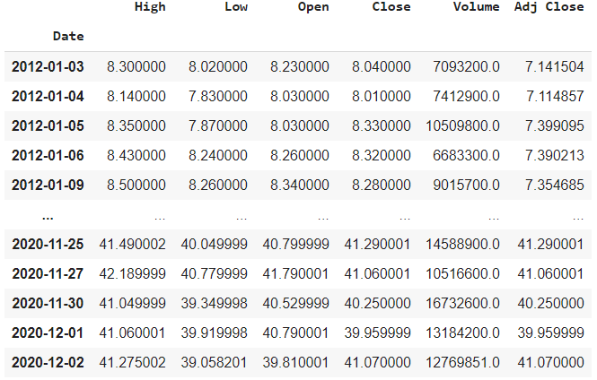
All about the Dataset
We have retrieved all the four stock prices data.
Having a look at the Delta Airlines Data.

Slide 6

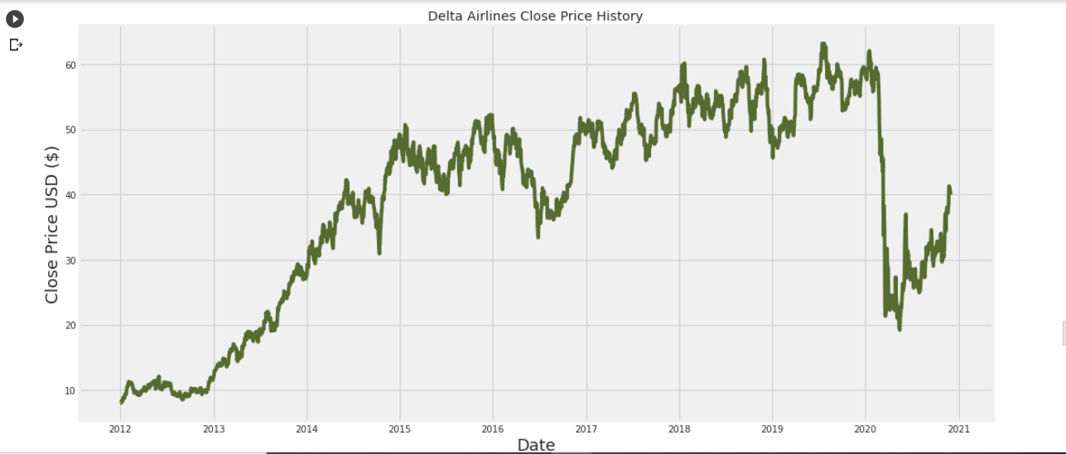
Historical Closing Prices
The graph for the historical closing prices for Delta Airlines is as follows.

Slide 7

LSTM
LSTM is a type of recurrent architecture of the neural network in which the vanishing gradient problem is solved.
LSTMs are capable of understanding long-term dependencies and operate on a wide range of issues.
LSTMs are very powerful in sequence prediction problems because they’re able to store past information.
The previous price of a stock is crucial in predicting its future price.
We have the previous stock price data which makes LSTM a great fit for our prediction.

Slide 8

Steps involved in LSTM
Steps included in LSTM :
Creating Data with Timesteps
Building the LSTM model to predicting future stock prices.
Using MinMaxScaler to transform the dataset.
Running the model on the training and testing dataset.
Plotting the prediction graph and analyzing the actual closing values and predicted values.

Slide 9

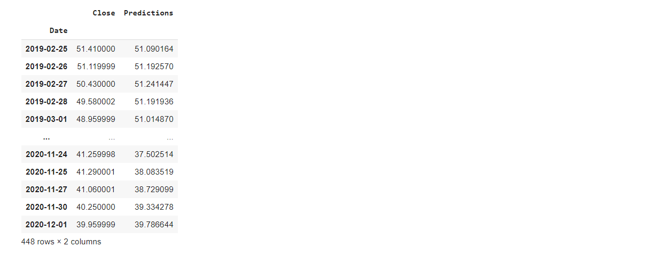
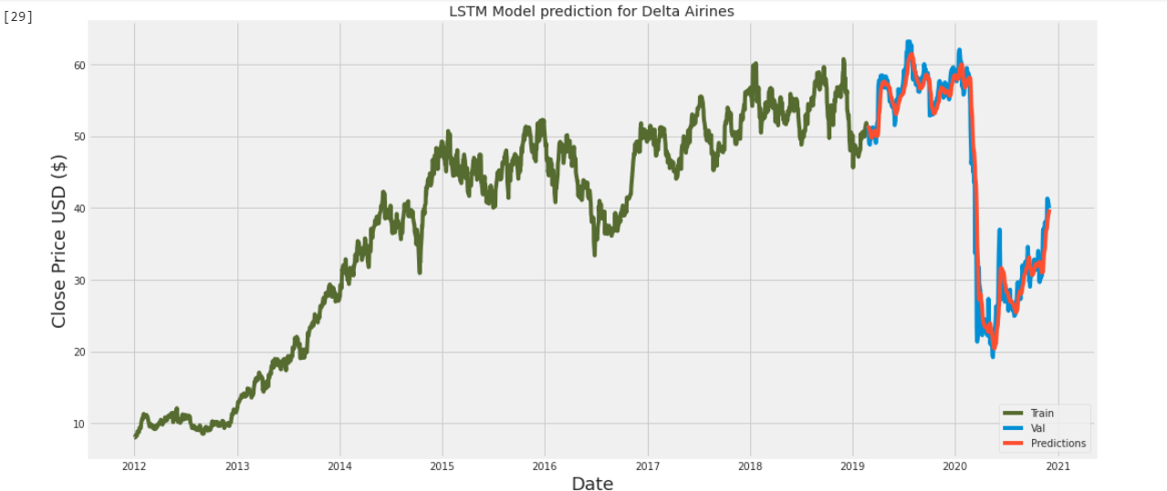
Visualizing the LSTM prediction results
Output of LSTM Model for Delta airlines :

Slide 10

TEXT SENTIMENT ANALYSIS
Recent happenings in the airline industry can be a great benefit in making a decision to invest in a stock.
Using Zero-shot text classification with Hugging face to decide the sentiment score of the text.
The text used here is latest Google news text.
The classifier needs to be run on a news article, which helps to decide the sentiment score.

Slide 11

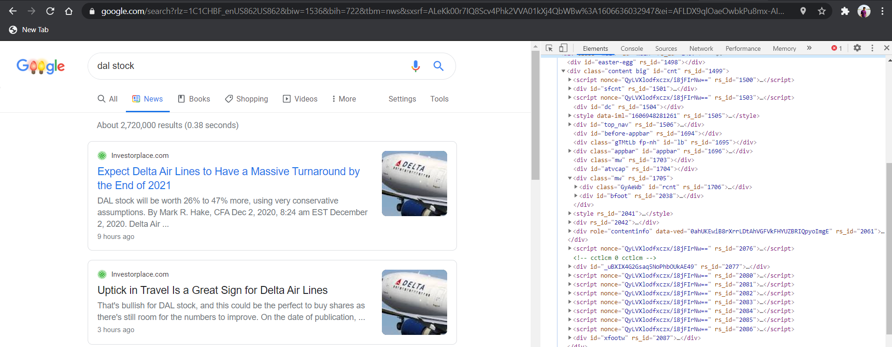
Scraping the Google News Text
Scraping the live news data from Google news.
The meta titles and meta descriptions are used here to perform the analysis.

Slide 12

Running the classifier
The scraped data that is obtained contains html tags, punctuations, and symbols.
Using Regular Expression to remove special characters from the data and transforming it into plain text.
The plain text is fed to the classifier to perform the analysis.
Candidate labels are added as POSITIVE and NEGATIVE
The scores are generated based on these candidate labels.

Slide 13

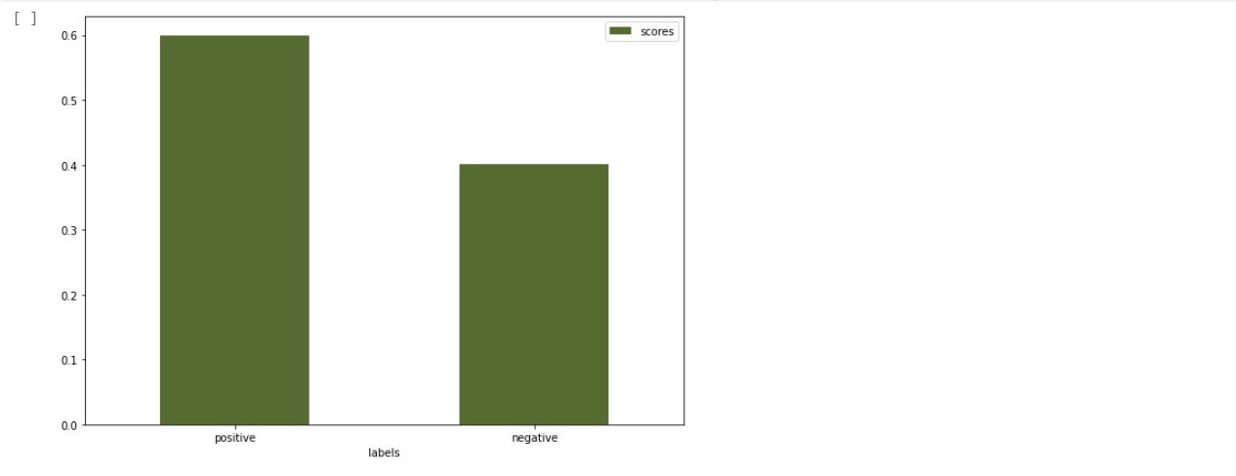
Sentiment Scores and Visualization
In our case, we will be using the Delta Airlines news articles.
We have passed the text to the classifier and generated the score.
The news article for Delta Airlines has a higher positive sentiment.

Slide 14

Conclusion
For stock price prediction using LSTM and text classification using zero-shot with hugging face, we can see that the predicted price has seen a rise than the previous date.
The model prediction accuracy is also 99.57%
The text sentiment classification is also higher on a positive scale.
That means we can recommend an investor to invest in Delta Airlines stock if they wish to.

Slide 15

Questions

Slide 16
THANK YOU

